Slide 1


Pyramid Principle
April 2023

Slide 2
Executive Summary
The individual has recently discovered the world of podcasts and believes that they are an excellent resource. They highlight the availability of podcasts across a broad range of topics and interests, making them an engaging source of information and entertainment. Podcasts are often bundled with other activities, like exercising or commuting, providing an added convenience to the listener. Additionally, many podcasts offer interviews with leaders from various fields, enabling listeners to stay up-to-date on the latest developments across different industries. Finally, the individual emphasizes the free accessibility of podcasts, unlike other forms of quality content that often come at a cost.

Slide 3
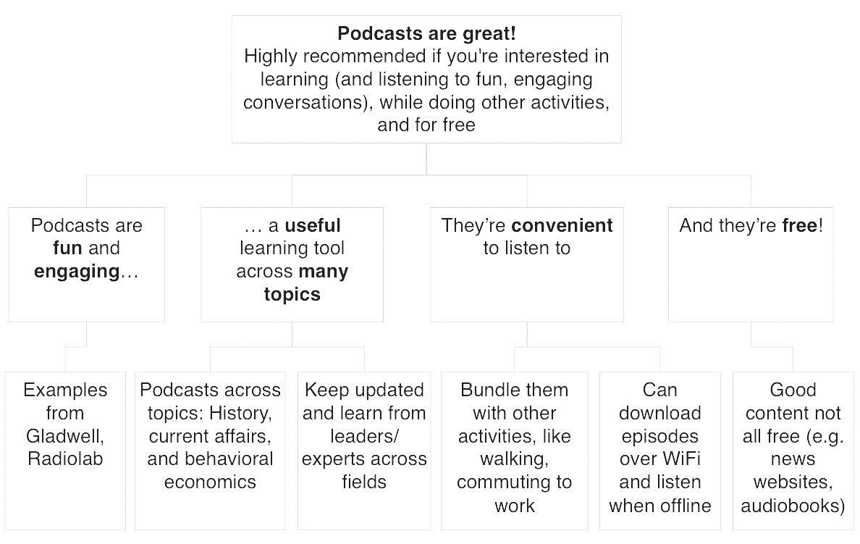

Slide 4


Thank You
We Blend in to Create Results that Stand Out

